Slide 1
Cognitive Radio & DSA

Slide 2
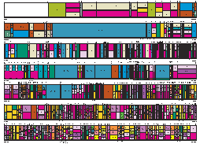
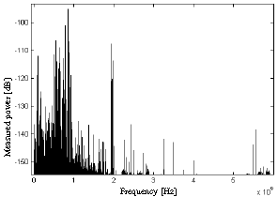
Static licensing :
Pros:
Effectively controls interferenc
Simple to design hardware
Cons:
Utilization of 0.5% in the 3-4 GHz
And 0.3% in 4-5 GHz
Multiple allocation over all of the band
A crisis of spectrum availability
A new approach to spectrum licensing is needed
Page <number>/32

Slide 3
Solutions ( what I want to present) :
Cognitive
Radio
1
Spectrum
management
Spectrum
mobility
Spectrum
sharing
A suggested
Architecture
(CORVUS)
sensing
Analyzing
Decision
2
cooperative
transmitter
energy
Match
filter
Dynamic
Spectrum
allocation
Cyclo
stationary
history
Different
types of
DSA
Example:
UMTS DVBT
merging
Driving
project
Interference
based
Page <number>/32

Slide 4
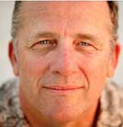
Cognitive radio :
“cognitive Radio” was first introduced by J.Mitola :
An intelligent wireless communication system that is aware of its surrounding environment (i.e., outside world), and uses the methodology of understanding-by-building to learn from the environment and adapt its internal states to statistical variations in the incoming RF stimuli by making corresponding changes in certain operating parameters (e.g., transmit-power, carrierfrequency, and modulation strategy) in real-time, with two primary objectives in mind:
· highly reliable communications whenever and wherever needed;
· efficient utilization of the radio spectrum.
Page <number>/32

Slide 5
Cognitive radio :
FCC definition :
A ‘‘Cognitive Radio’’ is a radio that
can change its transmitter parameters
(So must be Reconfigurable)
based on
interaction with the environment in which it operates.
(So must have some capabilities such as sensing)
Page <number>/32

Slide 6
Spectrum sensing:
An important requirement to sense the spectrum holes.
sensing
Transmitter
detection
Cooperative
detection
Interference-
Based
detection
Match filter
Energy
Cyclo stationary
Page <number>/32

Slide 7


Energy sensing:
Energy sensing can be performed in both time domain and frequency domain.
For either case, we consider the received signal of the form
y(n) = x(n) + z(n)
Time or freq. samples of received signal target signal AWGN
NB large
S :Gaussian random variable with:
Note that |y(n)|2 is a sequence of
(IID) random variables with :
Page <number>/32

Slide 8
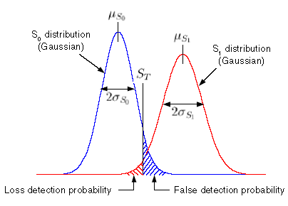

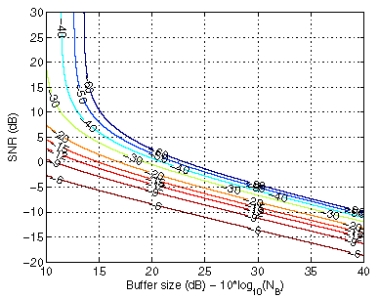

Energy detection (con.):
When there is no signal present,
i.e. x(n) = 0, the sensing metric is:
When there is signal present,
the sensing metric is:
Bad behavior in
Small buffer size
Page <number>/32

Slide 9
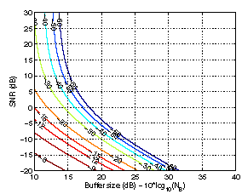



Match filter detection :
If a priori knowledge of primary user signal (such as modulation type, shaping signal, …) is available , Match filter detection is optimal because it maximizes SNR in AWGN channel
In this case :
When there is no signal present :
When there is signal present :
Better behavior in small buffer size
Page <number>/32

Slide 10
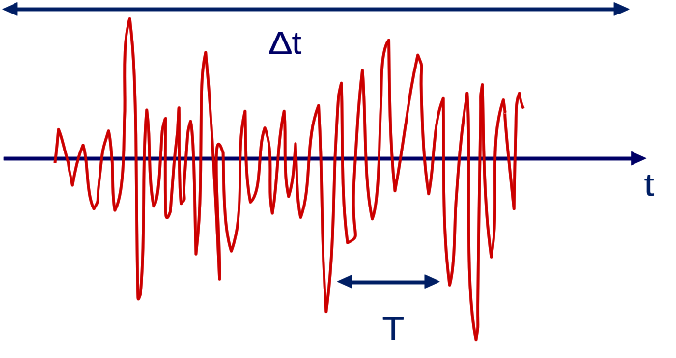
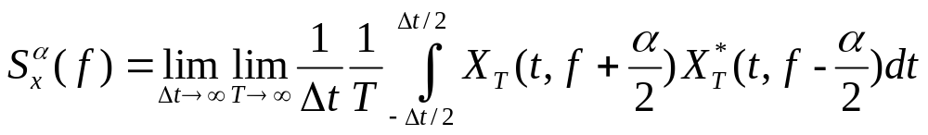
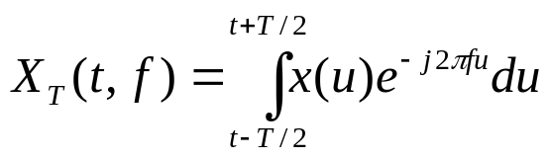
Cyclo-stationary detection :
modulated signals are characterized as cyclostationarity since their mean and autocorrelation exhibit periodicity.
These features are detected by analyzing a spectral correlation function.
S_{x}^{α} is a two dimensional complex transform on a support set (f, α)
Spectral correlation function can be used for feature detection
Page <number>/32

Slide 11
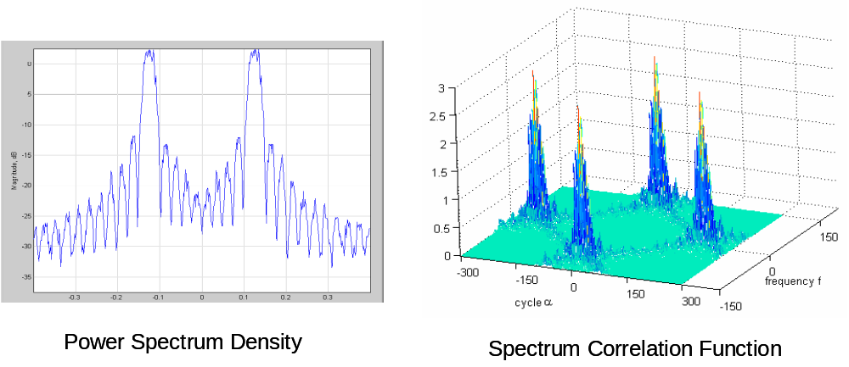
Example of Spectral Correlation Function
BPSK modulated signal:
  carrier at 125 MHz, bandwidth 20 MHz, square root raised cosine pulse shape with roll-off=0.25, sampling frequency 0.8 GHz
Page <number>/32

Slide 12


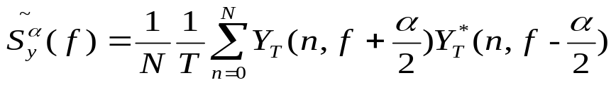
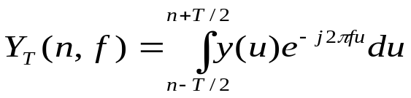
Cyclostationary Detection
Hypothesis testing: Is the primary signal out there?
x(n) is primary user signal with known modulation and S_{x}^{α}(f)
w(n) is noise with zero mean and unknown power N₀ that could vary over time
Spectral correlation function of y(n):
Noise is not cyclostationary process thus S_{w}^{α}(f)=0 for α≠0.
For fixed number of samples N compute estimate of SCF:
T pt. FFT around n^{th} sample
Page <number>/32

Slide 13
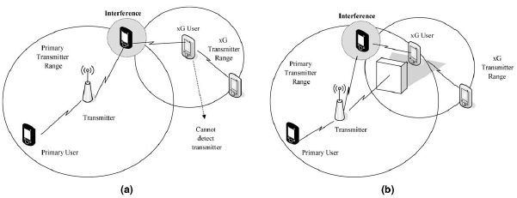
Cooperative detection :
Transmitter detection problems :
the sensing information from other users is required for more accurate detection.
Page <number>/32

Slide 14
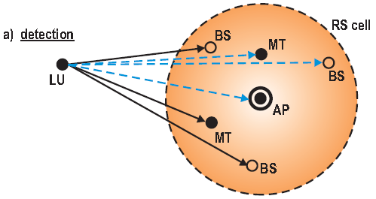
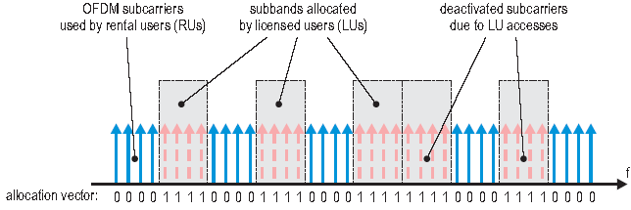
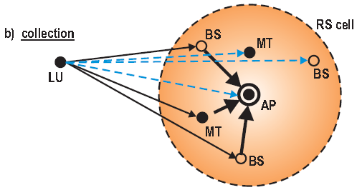
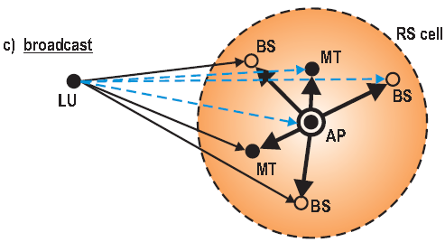
Strategy (in an OFDM C.R.):
It takes a long time to collect the results from each terminal in the form of the MAC packet
Suggested methods to decrease this time:
    reducing the number of detecting mobile terminals ( not interesting )
    physical layer operation instead of MAC layer operation
+
Protocol cycle of detection, collection and broadcast
Page <number>/32

Slide 15
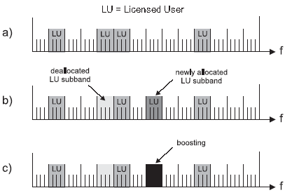
Collection of the measurement data:
First Phase
If a mobile terminal encounters a spectral access by a licensed user to a certain subband which was not announced by the access point, then it transmits complex symbols at maximum power level (e.g. 1 + j1) on these OFDM carriers where the new licensed user accesses were etected
Page <number>/32

Slide 16
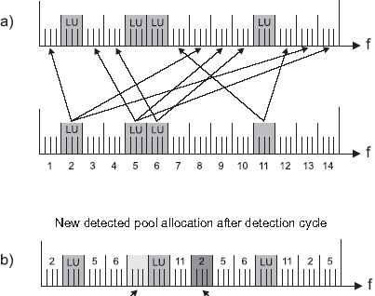

Collection of the measurement data(con.):
Second Phase
    One-to-one mapping between allocated and idle subbands
    Now, only the subbands that remain allocated are boosted
Page <number>/32

Slide 17
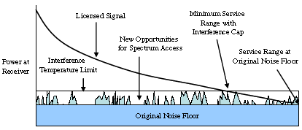
Interference based detection:
Instead of transmitter detection we can measure the interference level in receivers & use the freq. band until a receiver begins suffering from interference.
This approach is suitable for underlay (UWB) cognitive radios
Page <number>/32

Slide 18


Spectrum analysis: enables the characterization of different spectrum bands, which can be exploited to get the spectrum band appropriate to the user requirements.
these characteristics are:
        Interference
        Path loss
        Wireless link errors
        Link layer delay
        Holding time
Spectrum decision: Once all available spectrum bands are characterized,appropriate operating spectrum band should be selected for the current transmission considering the QoS requirements and the spectrum characteristics.
Page <number>/32

Slide 19
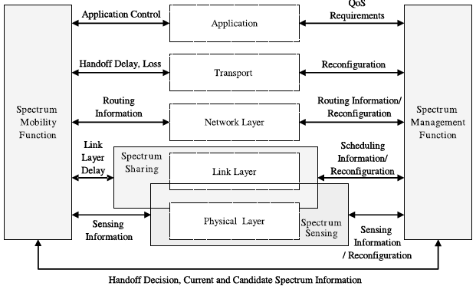
Spectrum mobility
In spectrum management and spectrum mobility functions, application, transport, routing, medium access and physical layer functionalities are carried out in a cooperative way, considering the dynamic nature of the underlying spectrum.
When
current channel becomes worse
or
a primary user appears
Spectrum mobility
Page <number>/32

Slide 20
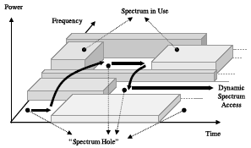
Spectrum mobility (con.):
Spectrum
mobility
Network
Protocol
adaption
For example:
FTP packets must be
stored & RT packets
must be discarded during
the mobility process.
TCP parameters must
be updated after mobility
according to new link
conditions such as delay,…
spectrum
management
Changing
The channel
condition
Page <number>/32

Slide 21
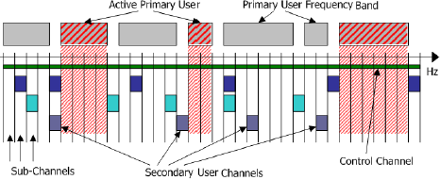
CORVUS
( a Cognitive Radio approach for usage of Virtual Unlicensed Spectrum)
the principle idea of a Spectrum Pooling system in CORVUS:
  Each spectrum pool is divided into N sub-channels.
  Sub-channels selected to create a SU Link should be scattered over multiple PU frequency.for two reasons:
        it limits the interference impact of a SU on a re-appearance of a PU
        if a PU appears during the lifetime of a SU Link it would impact very few (preferable one) of the Sub-Channels used by the SU Link
  for cooperative detection SUs work in groups & signal to each other via the control channel
1.Dedicated spectrum for this purpose
2.ISM/UNII
3.UWB
Carry a low bit rate signaling
Page <number>/32

Slide 22
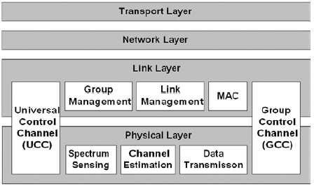
CORVUS:( CON.)
Physical layer :
  Sensing
  Channel estimation
  Data transmission ( parameter adjustment)
Link layer :
  Group management
  Link management (choosing ,setupping ,maintaining a connection)
  MAC (resolve the competition)
Page <number>/32

Slide 23

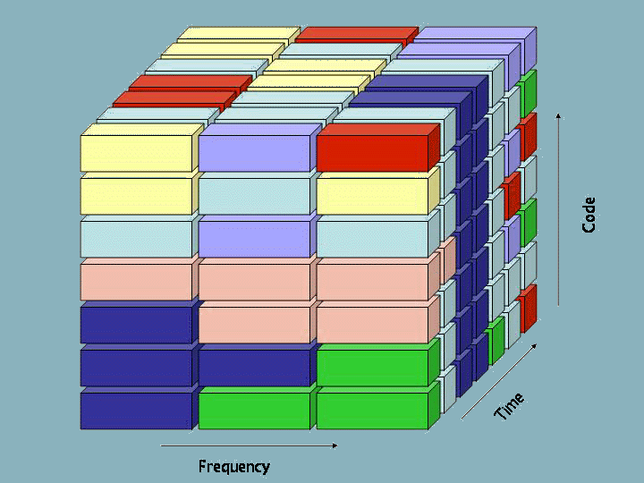
Dynamic Spectrum Allocation : (DSA)
Spectrum is valuable and our current regularity wastes it
DSA aims to manage the spectrum utilized by a converged radio system and share it between participating radio networks over space and time to increase overall spectrum efficiency.
Must be re-regulated to
Page <number>/32

Slide 24
History :
Introduced at the World Radio Conference (WRC) 2000
Discussed at WRC 2003 and suggested as an agenda item for WRC 2010 ; further studies will he done until that time.
Discussions have also started on a national level :
    U.K :
      spectrum trading should be implemented in the UK as soon as possible
      Broadcasters should he given the ability to lease spectrum to other uses and/or users.
    U.S :
      FCC: “preliminary data and general observations indicate that many portions of the radio spectrum are not in use for significant periods of time, and that spectrum use of these ‘white spaces’ (both temporal and geo- graphic) can he increased significantly”
These regulatory developments show that there is a perceived need to bring regulations up to date
Page <number>/32

Slide 25
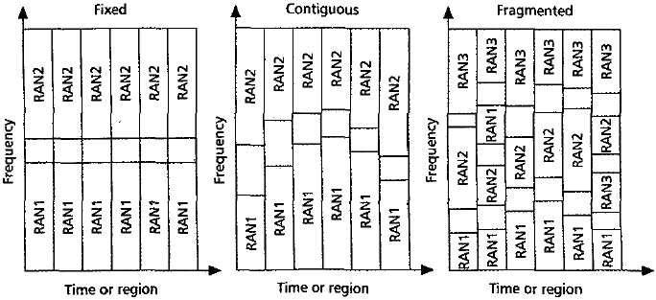
Methods for DSA:
Fixed : current regulations
Contiguous : contiguous blocks of spectrum with variable boundaries allocated to different RANs
Fragmented : any RAN can he assigned an arbitrary piece of spectrum anywhere in the band
Page <number>/32

Slide 26
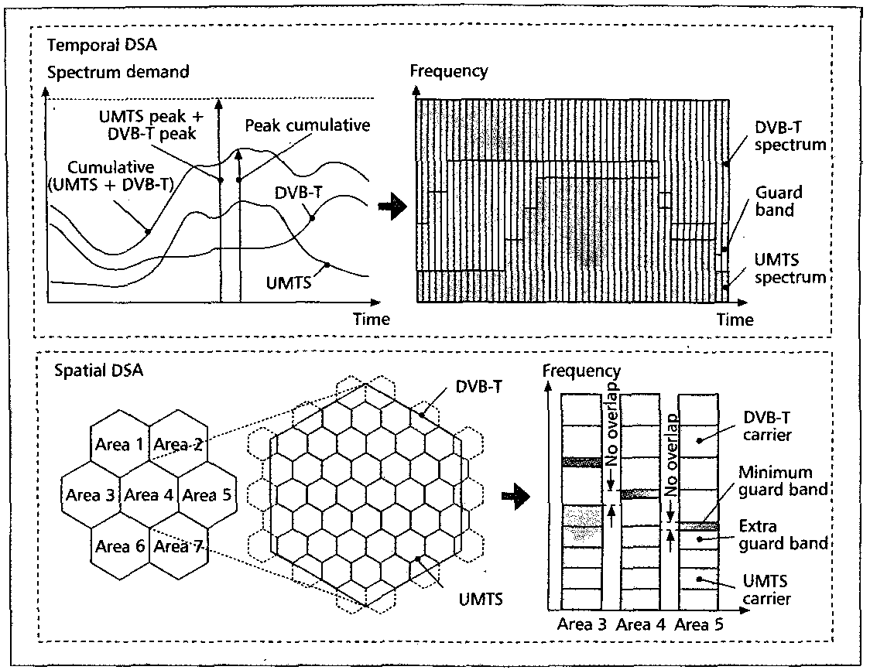
Example : ( UMTS , DVBT merging )
Temporal DSA
Spatial DSA
Page <number>/32

Slide 27
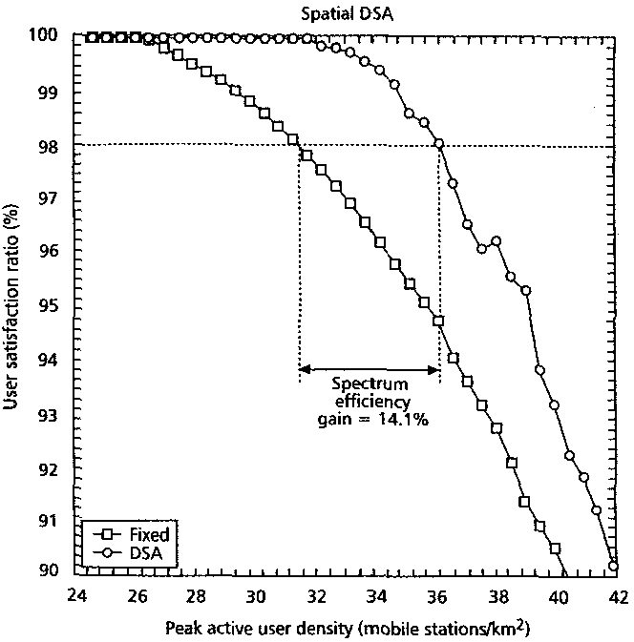
Fix vs. dynamic allocation :
Page <number>/32

Slide 28
DSA requirements:
Network
Physical layer ( we focus on it )
    Flexible frequency carrier tuning
    Variable duplex distances between the for- ward and reverse links for frequency division duplex (FDD)-based systems
    Flexible receiver signal filtering
The required flexibility for DSA can be achieved with SDR-based reconfigurable equipment
If you want to know Current and breakthrough key enabling technologies for reconfigurable equipment, click here
Page <number>/32

Slide 29
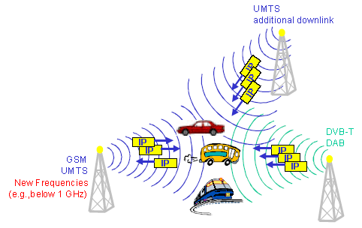
Drive :
Dynamic Radio for IP Services in Vehicular Environments
aims at coordination of existing radio networks into a hybrid network to ensure spectrum efficient provision of mobile multimedia services
Provide mechanisms for spectrum sharing between systems using Dynamic Spectrum Allocation (DSA)
Page <number>/32

Slide 30
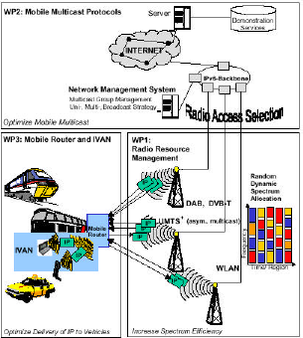
Driving : (con.)
The dynamic nature of this network is a major challenge to the routing itself and also on the update of the routing tables
Has two approaches to increase spectrum efficiency :
  System selection :
    Spectrum efficiency can be increased by choosing the optimum transmission technology for a given load scenario.
      As an example: Transmission via a DAB broadcast link should be preferred in a scenario where many mobile users are requesting the same data. Several point-to-point UMTS links would considerably waste bandwidth
  Dynamic spectrum allocation (DSA)
Page <number>/32

Slide 31

References :
NeXt generation/dynamic spectrum access/cognitive radio wireless networks: A survey ,by Ian F. Akyildiz, Won-Yeol Lee, Mehmet C. Vuran *, Shantidev Mohanty @ ELSERVIER
L. Xu, R. Tonjes, T. Paila, W. Hansmann, M. Frank, M.Albrecht, DRiVE-ing to the internet: dynamic radio for ip services in vehicular environments, in: Proc. of 25th AnnualIEEE Conference on Local Computer Networks, November2000, pp. 281–289.
T.A. Weiss, J. Hillenbrand, A. Krohn, F.K. Jondral,Efficient signaling of spectral resources in spectrum pooling systems, in: Proc. 10th Symposium on Communications and Vehicular Technology (SCVT), November 2003.
T.A. Weiss, F.K. Jondral, Spectrum pooling: an innovative strategy for the enhancement of spectrum efficiency, IEEE Radio Communication Magazine 42 (March) (2004) 8–14.
R.W. Brodersen, A. Wolisz, D. Cabric, S.M. Mishra, D.Willkomm, Corvus: a cognitive radio approach for usage of virtual unlicensed spectrum, Berkeley Wireless Research Center (BWRC) White paper, 2004.
P. Leaves, K. Moessner, R. Tafazoli, D. Grandblaise, D.Bourse, R. Tonjes, M. Breveglieri, Dynamic spectrum allocation in composite reconfigurable wireless networks, IEEE Comm. Magazine, vol. 42, May 2004, pp. 72–81.
Some Physical Layer Issues of Wide-band Cognitive Radio Systems by Haiyun Tang @ IEEE 2005
Thanks from Anant Sahai, Danijela Cabric for their slides on cyclostationary detection
Page <number>/32

